Slide 1


Department of Computer Science and Engineering
DETECTION AND CLASSIFICATION OF DIABETIC RETINOPATHY USING INCEPTION V3 AND XCEPTION ARCHITECTURES
BHARGHAVI J [211419104041]
DEEPTHI H [211419104052]
MATHUMITA B [211419104164]
Guide Name
Ms.V.Sathiya
Coordinator Name
Dr. Kavitha Subramani, M.E., Ph.D.,
1

Slide 2
Abstract
Diabetic Retinopathy (DR) occurs when there is damage to the retina, particularly in patients with diabetes.
This is caused when the increased sugar level in the blood blocks the vessels that nourish the retina by cutting off its blood supply. As a result, the eye attempts to grow new abnormal blood cells that can be leaked out easily from the vessels.
Diabetic retinopathy detection contains three steps: preprocessing of colour fundus images, diagnostic feature extraction and classification of diabetic retinopathy.
We used Inception V3 for detection of diabetic retinopathy in a person and Xception for diabetic retinopathy classification.
As a result, our research can help diabetic retinopathy patients reduce their chances of becoming blind for life.

Slide 3
Literature Survey
S.NO​ ​ | YEAR​ | AUTHOR NAME​ | PAPER TITLE​ | METHODOLOGY​ | MERITS &​ DEMERITS​ | FUTURE SCOPE​
1​ | 2021​ | Harshit Kaushik,Dilbag Singh,Manjit Kaur,Hammam Alshazly,​ Atef Zaguiaand Habib Hamam​ | TITLE: Diabetic Retinopathy Diagnosis From Fundus Images Using Stacked Generalization of Deep Models​ JOURNAL: IEEE ACCESS​ VOLUME: 9​ DATE OF PUBLICATION: July 28,2021​ ​ ​ ​ | Three different sub-models of CNNs are fed into a single meta-learner classifier for feature extraction. Data augmentation technique is also applied to improve the diversity of images in the dataset. Finally, the meta-learner classifier produces the diagnostic result as healthy (No DR) or unhealthy (DR). ​ ​ | MERITS:​ This model reports an overall test accuracy of 97.92% in binary classification and 87.45% multi-class classification​ DEMERITS:​ The images of the model are available in the .JPEG format. Since it is a lossy compression, the images lose a significant amount of information.​ | Diversifying and increasing the images in the dataset for improving the feature extraction capabilities. ​ ​

Slide 4
Literature Survey
S.NO​ ​ | YEAR​ | AUTHOR NAME​ | PAPER TITLE​ | METHODOLOGY​ | MERITS &​ DEMERITS​ | FUTURE SCOPE​
2​ | 2021​ | Mohamed M.Abdel Salam, ​ M.A.Zahran​ | TITLE: A Novel Approach of Diabetic Retinopathy Early Detection Based on Multifractal Geometry Analysis for OCTA Macular Images Using Support Vector Machine​ JOURNAL: IEEE ACCESS​ VOLUME: 9​ DATE OF PUBLICATION: January 26, 2021​ | Used a supervised machine learning method as a Support Vector Machine (SVM) algorithm to automate the diagnosis process and improving the resultant accuracy.​ | MERITS:​ The proposed technique has achieved an accuracy of 98.7% to detect Early Diabetic Retinopathy.​ ​ DEMERITS:​ This model cannot detect the different stages of Diabetic Retinopathy.​ ​ ​ | Design a new GUI application that can extract the selected image features for early detection and diagnosis. The detection and extraction of malignant.​ ​

Slide 5
Literature Survey
S.NO​ ​ | YEAR​ | AUTHOR NAME​ | PAPER TITLE​ | METHODOLOGY​ | MERITS &​ DEMERITS​ | FUTURE SCOPE​
3​ | 2022​ | Mohamed M.Farag,​ Mariam Foud,​ Amr T.Abdel-Hamid​ | TITLE: Automatic Severity Classification of Diabetic Retinopathy Based on DenseNet and Convolutional Block Attention Module.​ JOURNAL: IEEE ACCESS​ VOLUME: 10​ DATE OF ​ PUBLICATION: April 6, 2022​ ​ ​ | The proposed technique employs DenseNet169’s encoder to construct a visual embedding. Convolutional Block Attention Module (CBAM) is introduced on top of the encoder to reinforce its discriminative power. The model is trained using cross-entropy loss on the Kaggle Asia Paciﬁc Tele-Ophthalmology Society’s (APTOS) dataset.​ | MERITS:​ Efﬁciently grades the severity level of diabetic retinopathy while reducing the time and space complexity.​ ​ DEMERITS:​ The model cannot detect the types of Diabetic Retinopathy.​ ​ ​ | For future research direction, we evaluate the performance of different CBAM configurations. Moreover, experimenting with different imbalanced learning techniques and increasing the dataset size will lead to better performance. ​

Slide 6
Literature Survey
S.NO​ ​ | YEAR​ | AUTHOR NAME​ | PAPER TITLE​ | METHODOLOGY​ | MERITS &​ DEMERITS​ | FUTURE SCOPE​
4​ | 2019​ | Zhentao Gao, Jie Li, Jixiang Guo,Yuanyuan Chen, Zhang Yi, Jie Zhong ​ ​ ​ | TITLE: Diagnosis of Diabetic Retinopathy Using Deep Neural Networks​ PUBLISHER: IEEE​ Cite This​ PDF​ Jadoon ​ JOURNAL:IEEE ACCESS​ VOLUME: 7​ DATE OF ​ PUBLICATION:​ 19 December 2019​ ​ | In this paper, new dataset of fundus images are used for grading DR. In contrast to existing scales that grade fundus images mainly by the pathological changes in the retina. With this dataset, several deep convolutional neural network (DCNN) models were trained for the diagnosis of DR.​ ​ ​ | MERITS:​ With this dataset, several deep convolutional neural network (DCNN) models were trained for the diagnosis of DR. Our models were also deployed for clinical evaluation in several hospitals​ DEMERITS:​ The I/O operation for reading the images from the disk takes a lot of time​ | In the future, data from more equipments will be included, and a broader pilot study will be launched. The accumulated data will be further used to improve the accuracy of the models.​

Slide 7
Problem Statement
The objective of this project is to accurately detect whether a person has been affected with diabetic retinopathy, so that we can prevent patients from becoming blind for life.
Diabetes retinopathy has no symptoms in its early stages. Gradually, some people notice changes in their vision in the later phases, such as reading difficulty or not being able to see faraway objects.
The goal is to create a web-based application that recognises Diabetic Retinopathy (DR) in a person and if so, this model will determine the severity and type of Diabetic Retinopathy.
Due to the fact that this app is online, anyone with internet access can easily use it to determine Diabetic Retinopathy by uploading the retinal images as the input to the system.
Two deep learning algorithms were used in this case to boost the accuracy by 98%. Inception V3 for detection, and Xception for classification.

Slide 8
Proposed System
Preprocessing (quality enhancement and removal of irrelevant details from images )
A Median Filter (noise removal) and Adaptive Histogram Equalization (image enhancement)
Inception V3(detection of diabetic retinopathy)
Xception(classification of diabetic retinopathy :Microaneurysms, Haemorrhages and Exudates)
Advantages of proposed system
The proposed system can determine the specific type of DR in abnormal retinal images.​
The classification accuracy is high due to image pre-processing technique.​
The processing speed is high , so it has less computational time.

Slide 9
Software / Hardware used
Software Requirements:
Operating System – Windows 10​
Coding Language – Python 3.11​
IDE – Visual Studio Code​
Package Manager – PIP​
Framework – Streamlit
2. Hardware requirements:
System – Core i5 Processor​
Hard Disk – 500 GB​
Monitor – 15'' LED​
Input Devices – Keyboard, Mouse​
RAM – 4GB

Slide 10
Methodology used
1. IMAGE AQUISITION: In image processing and image acquisition contexts, this is a method of extracting an image from a certain source, generally a hardware-based source. The IDRiD database is used to gather retinal images
2. PRE-PROCESSING: The second stage is preprocessing, which includes image resizing and noise removal. The noise in the retinal image is eliminated using a median filter.
3. DIABETIC RETINOPATHY DETECTION: After preprocessing, features from retinal images are extracted and classified using the Inception V3 model
4. DR CLASSIFICATION: Xception is used to classify the images of diabetic retinopathy into three types : microaneurysms, hemorrhages, and exudates, based on hyper parameters like epochs, learning rate, dropout, and optimizer (ADAM).
5. PERFORMANCE MEASURE: The effectiveness of this prototype was measured in terms of precision, recall, F1 score performance metrics, and accuracy.

Slide 11
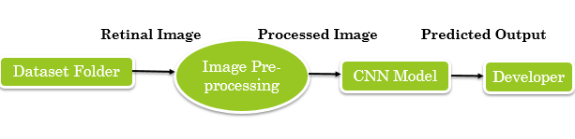
System Design
DATA FLOW DIAGRAM
Level 0 :

Slide 12
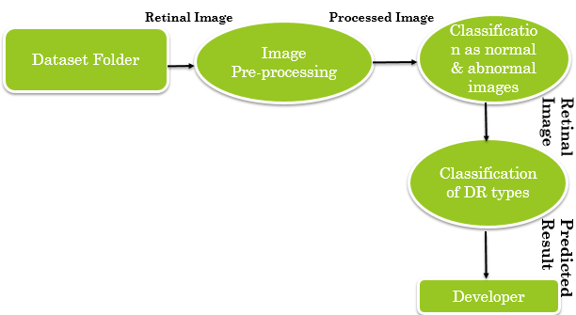
System Design
Level 1 :

Slide 13
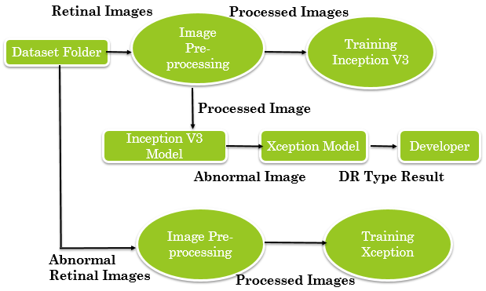
System Design
Level 2 :

Slide 14
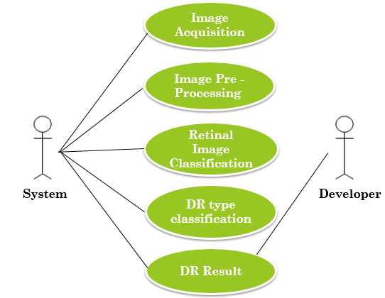
System Design
USE CASE DIAGRAM

Slide 15
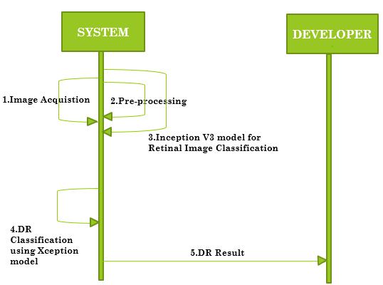
System Design
SEQUENCE DIAGRAM

Slide 16
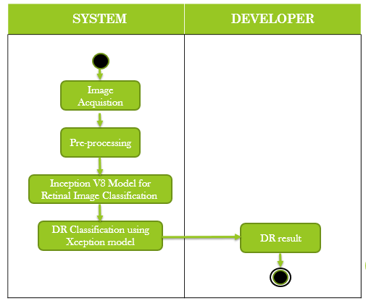
System Design
ACTIVITY DIAGRAM

Slide 17
Module Description
PRE-PROCESSING DATASET
Pre-processing includes noise removal and contrast enhancement.
Median filter is an algorithm used to remove the noise in the retinal image.
Image contrast is enhanced by Adaptive Histogram Equalization (AHE) process.
Adaptive histogram equalization (AHE) is a computer image processing technique used to improve contrast in retinal images.

Slide 18
CLASSIFICATION OF RETINAL IMAGES
Module Description
Following pre-processing, an Inception V3 model is used to extract features and classify retinal images.
Inception V3 has 48 layers, and the input size is 299 by 299 pixels.
Based on the hyperparameters such as epochs, learning rate, dropout, and optimizer (ADAM), the proposed model is trained to build a classification prediction that classifies the retinal image into normal and abnormal (diabetic retinopathy) retinal image.

Slide 19
Module Description
CLASSIFICATION OF DIABETIC RETINOPATHY
In this module, abnormal retinal images (DR) are carried out to classify the diabetic retinopathy images into three types using Xception deep learning model.
Xception has 71 layers, and the input size is 299 by 299 pixels.
Based on the hyperparameters such as epochs, learning rate, dropout, and optimizer (ADAM), the proposed model was trained to build a classification prediction that classifies the DR retinal image into three types, such as Microaneurysms, Haemorrhages, and Exudates.

Slide 20
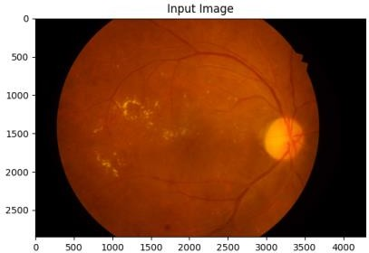
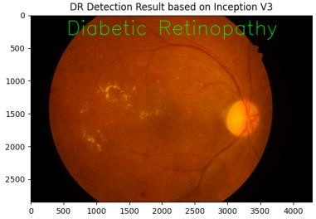
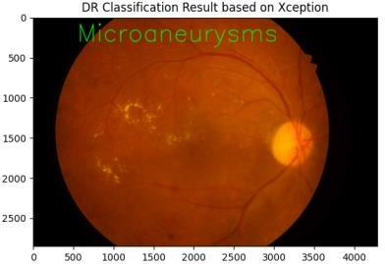
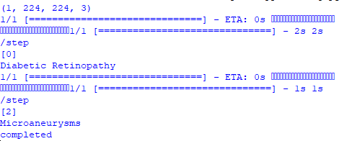
Testing – Program
DETECTION AND CLASSIFICATION
DR Detection based on Inception V3
DR Classification based on Xception
Read Testing image
OUTPUT

Slide 21
Testing – Application
Action | Input | Expected Output | Actual Output | Test Result
Launch streamlit app using “streamlit run app.py” | http://localhost:8501/ | DR detection and classification web app | DR detection and classification web app | Pass
Detection of diabetic retinopathy | Upload fundus image that have diabetic retinopathy | Diabetic retinopathy | Diabetic retinopathy | Pass
Classification of diabetic retinopathy | Upload fundus image that have diabetic retinopathy | Exudates | Exudates | Pass
Detection of diabetic retinopathy | Upload fundus image that doesn’t have diabetic retinopathy | No diabetic retinopathy | No diabetic retinopathy | Pass

Slide 22
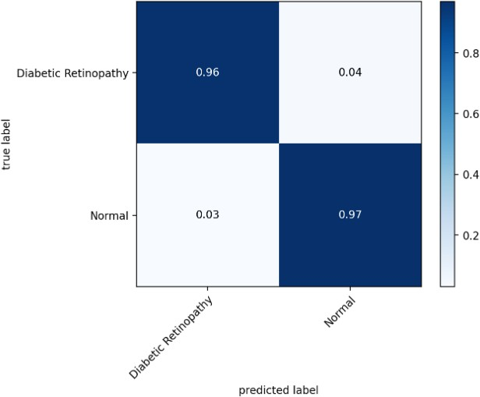
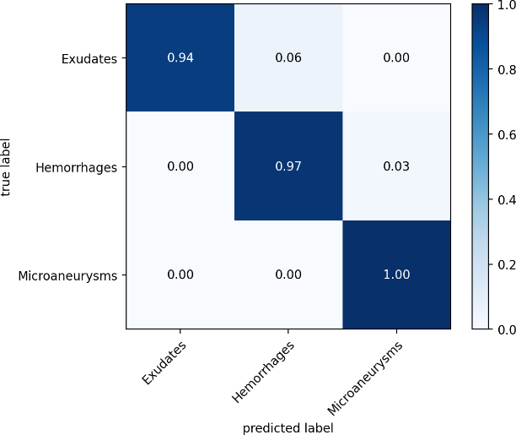
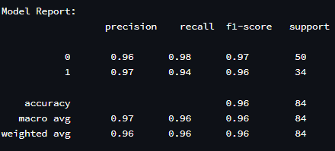
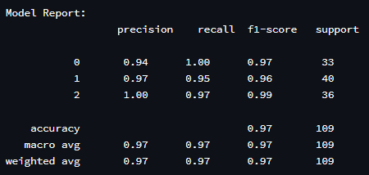
Performance Evaluation
Performance analysis for DR detection
Performance analysis for DR classification
Detection report
Classification report

Slide 23
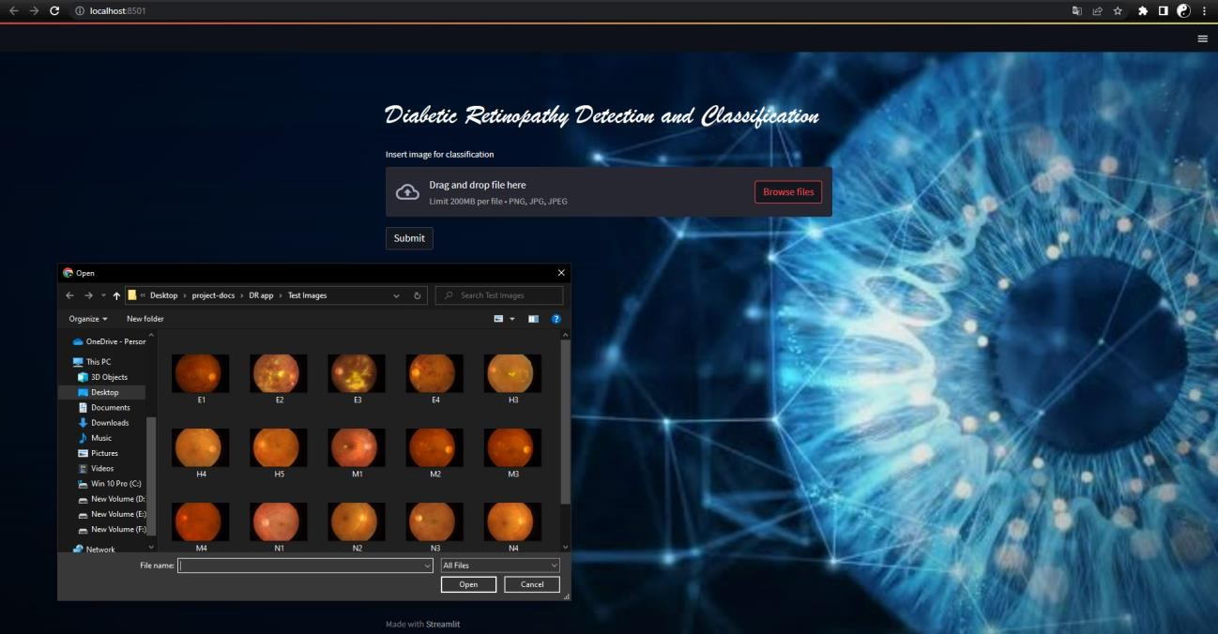
Screenshots
Input Image Selection

Slide 24
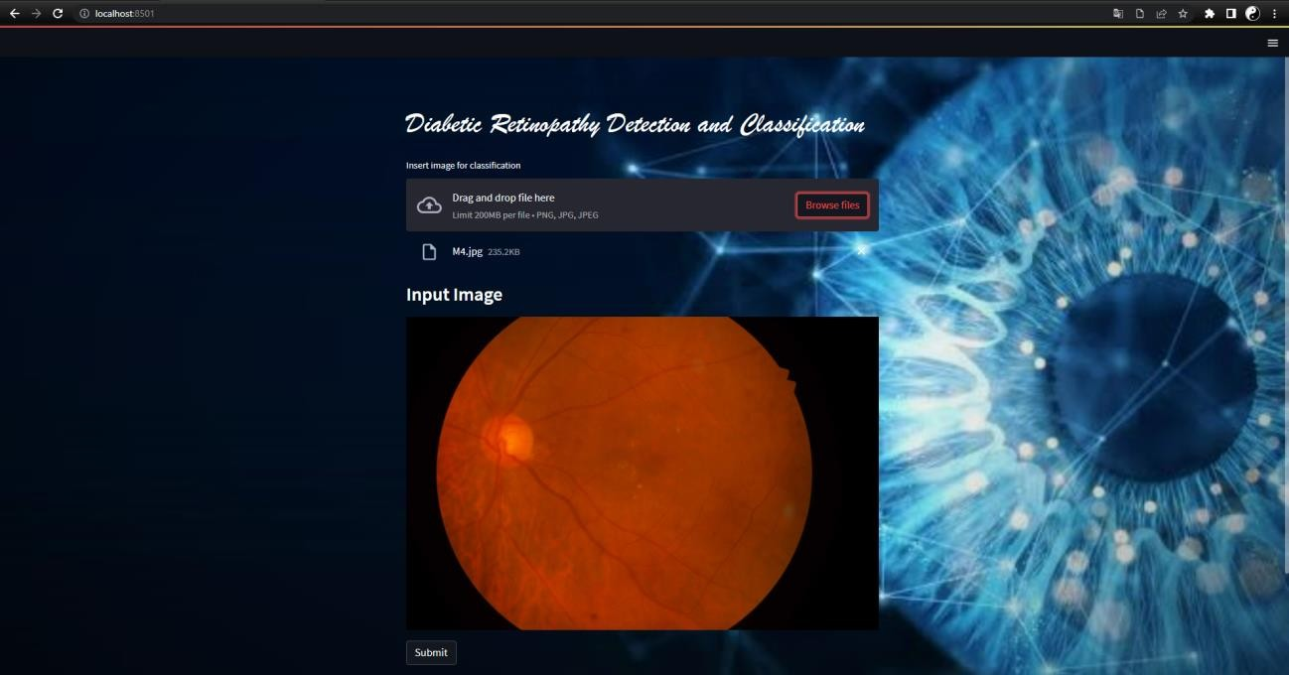
Screenshots
Input Image Upload

Slide 25
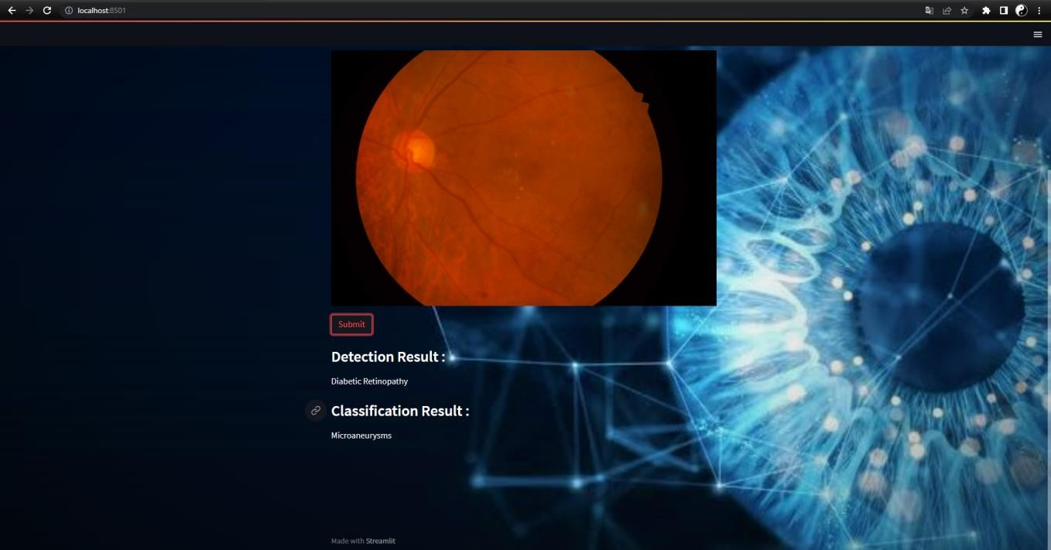
Screenshots
Detection & Classification Result

Slide 26
Conclusion / Feature Enhancement
In this research, we suggested a model relying on these Inception V3 and Xception architectures for the identification and classification of retinopathy.
On the basis of hyper parameters, the suggested network models were enhanced for better categorization.
With our proposed model, we have achieved 98% accuracy.
The results of the studies show that the CNN model we've suggested can correctly categorize distinct Diabetic Retinopathy types.
Since artificial intelligence technology is advancing, a potential future extension of this work includes detection of the affected area of retina for diabetic retinopathy patients using deep learning algorithms and displaying the affected area along with result for providing better treatment.

Slide 27
Reference Paper/ URL
Farag, M. M., Fouad, M., & Abdel-Hamid, A. T. (2022). Automatic severity classification of diabetic retinopathy based on denseNet and convolutional block attention module. IEEE Access, 10, 38299- 38308.
Mustafa, H., Ali, S. F., Bilal, M., & Hanif, M. S. (2022). Multi-stream deep neural network for diabetic retinopathy severity classification under a boosting framework. IEEE Access, 10, 113172- 113183.
Kaushik, H., Singh, D., Kaur, M., Alshazly, H., Zaguia, A., & Hamam, H. (2021) Diabetic retinopathy diagnosis from fundus images using stacked generalization of deep models. IEEE Access, 9, 108276-108292.
Khan, Z., Khan, F. G., Khan, A., Rehman, Z. U., Shah, S., Qummar, S., & Pack,S. (2021). Diabetic retinopathy detection using VGG-NIN a deep learning architecture. IEEE Access, 9, 61408-61416.
Masood, S., Luthra, T., Sundriyal, H., & Ahmed, M. (2017, May). Identification of diabetic retinopathy in eye images using transfer learning. In 2017 international conference on computing, communication and automation (ICCCA) (pp. 1183- 1187). IEEE.

Slide 28
Reference Paper/ URL
Saeed, F., Hussain, M., & Aboalsamh, H. A. (2021). Automatic diabetic retinopathy diagnosis using adaptive finetuned convolutional neural network. IEEE Access, 9, 41344-41359.
Zeng, X., Chen, H., Luo, Y., & Ye, W. (2019). Automated diabetic retinopathy detection based on binocular siamese-like convolutional neural network. IEEE access, 7, 30744-30753.
Liu, T., Chen, Y., Shen, H., Zhou, R., Zhang, M., Liu, T., & Liu, J. (2021). A novel diabetic retinopathy detection approach based on deep symmetric convolutional neural network. IEEE Access, 9, 160552-160558
Subhashini, R., Nithin, T. N. R., & Koushik, U. M. S. (2019). Diabetic retinopathy detection using image processing (gui). International Journal of Recent Technology and Engineering, 8(2).
Kwasigroch, A., Jarzembinski, B., & Grochowski, M. (2018, May). Deep CNN based decision support system for detection and assessing the stage of diabetic retinopathy. In 2018 International Interdisciplinary PhD Workshop (IIPhDW) (pp. 111-116). IEEE.

